Slide 1
Business and Technical motivations for Web Services

Slide 2
What are Web Services?
Web service – Loosely coupled, contracted component that communicate via XML-based interfaces
Loosely coupled – Web services and the programs which are using web services are changed independently of each other

Slide 3
…Contd
Contracted – Web service’s behavior, its input and output parameters, how to bind are publicly available
Component (Encapsulated code) – Implementation of each component is hidden from outside the component

Slide 4
Business Motivation for Web service
Vision of e-commerce
B2B integration
– allowing applications from different organizations to communicate across the Internet
A2A integration
– allowing applications within an organization to communicate across an Intranet

Slide 5
What is that we want in e-commerce?
All participants in each trading group need to agree upon single business vocabulary
Example
Quantity is being referred by number of boxes by one company and the pallets by another company

Slide 6
Technical Motivations
In earlier days mainframes were used to run the programs.
Replacement of it involved cost. Programmers added functionality with the coding
Complexity increased. To some extent object oriented programming reduces the complexity

Slide 7
…Contd
Programs were on single machine
RPC solves the problem by enabling the development of components on different systems
CORBA and DCOM are two successful architectures.
In RPC, we need to have code working on two different systems and a code that handles communication between the systems

Slide 8
…Contd
DCOM – Microsoft based architecture
CORBA – It is interoperable across the platform. However, it is complex

Slide 9
Comparison
 | DCOM | CORBA | Web Services
Payload Format | Network data representation (NDR) | DCOM | XML
Object References | Object reference | Interoperable object reference | URLs
Protocol | IIOP | ORPC | SOAP

Slide 10
What is Service Oriented Architecture?
The SOA organizes Web Services into three basic roles: the service
provider, the service requester, and the service registry.
Service providers publish their services to a service registry.
Service requesters can find the desired Web Services by searching for their descriptions at registry.
Once the requester locates the desired service, its client binds with the service at the service provider and then invokes the service.
SOA is responsible for describing and organizing the mechanisms for each of the above actions.

Slide 11
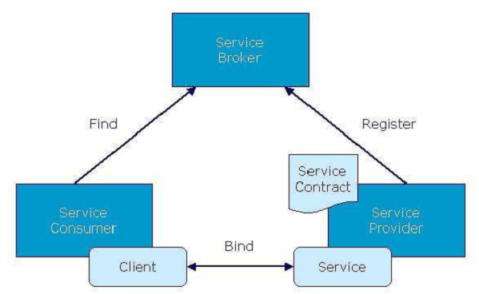

Slide 12
Functional Components
Service Implementation
Publication
Discovery & Invocation
JIT Integration
Semantic and Taxonomies
Security
QoS and Rel iable Messaging
Composition

Slide 13
Service Implementation
Four methods for building a web service:
1. Develop a new web service and a new service interface:
– Develop a WS as specified by business requirements
– Define its interface, publish and deploy the WS
2. Develop a new web service when there is an existing service interface:
– Locate the existing service interface by searching a registry of
WS.
– Generate a service implementation template that contains al l
methods and parameters that WS must support.
– Develop the WS as before.

Slide 14
…contd
3. Develop a new service interface for an existing application:
– Develop a WS wrapper for existing appl ication.
– The wrapper then exposes the service interface.
4. Create a WS that wraps an existing appl ication when you have an existing service interface:
– Find the service interface and then generate the service implementation template.
– Use this template to develop the wrapper for the existing applications.

Slide 15
Publication
Three steps to publish a WS:
1. Author the WS description document – WSDL describes
– What the WS wi ll do
– Where it can be found
– How to invoke it
2. Publ ish the WS description document on a Web server.
3. Publ ish the existence of your document in a WS registry using the UDDI spec.
– Registries can be global, public registries or restricted to
individual enterprise or to a closed group of companies.

Slide 16
Discovery and Invocation
Discovery and Invocation
Once published, any appl ication can discover and locate WS description document.
Once WSDL is located in the form of URI, WSDL file could be downloaded.
Two steps to invoke a WS:
Author a client using SOAP.
Make a SOAP call – client create SOAP message and sends it to remote WS. WS returns a SOAP message in the format as mentioned in WSDL

Slide 17
JIT Integration
JIT integration capabil ities of SOA provide new organizing principles.
The global set of WS grows and changes rapidly.
The owner determines the functional ity and inteface that it exposes.
Hence no master architect or executive committee is responsible for maintaining the system.

Slide 18
Semantics and Taxonomies
Semantics is the stickingpoint for any distributed system
EDI’s rigid format leads to semantic ambiguities
OO solves the semantics to some extent. However, semantics of the given class cannot be understood from the interface alone
Advent of XML addresses the semantic problem to some extent

